Slide 1
Language-Driven Scenario Generation for
Reproducible Social Navigation in a 2D Simulator
Team LetsGo: Yubin C., James S.

Slide 2
Motivation & Gaps in Prior Work
Social navigation policies are usually tested on small, hand-crafted scenario sets.
Benchmarks such as SocNavBench[1] provide standardized metrics, but adding new scenarios is still manual and slow.
SocRATES [2] shows that LLMs can help author social-nav scenes, but the pipeline is loosely constrained and not tightly coupled to a concrete simulator + validator.
Scenario languages like Scenic support rich constraints but require users to program distributions, not write natural language.
We lack a way to go from natural-language descriptions to validated, reproducible, simulator-ready 2D social-navigation scenarios at scale.
[1] Biswas, Abhijat, et al. "Socnavbench: A grounded simulation testing framework for evaluating social navigation." ACM Transactions on Human-Robot Interaction (THRI) 11.3 (2022): 1-24.
[2] Marpally, Shashank Rao, Pranav Goyal, and Harold Soh. "SocRATES: Towards Automated Scenario-based Testing of Social Navigation Algorithms." arXiv preprint arXiv:2412.19595 (2024).

Slide 3
Key Idea
Technical Approach Sketch
Treat language as a front-end to a constrained scenario language
Constrain an LLM with a strict JSON schema and a validator + auto-repair layer.
Language → JSON
  NL prompt → LLM in structured-JSON mode → scenario JSON with metadata, etc.
Constraint / Repair Layer
  No overlaps, in-bounds, corridor width ≥ formation width, spawn separation.
  Enforce basic social norms: passing side, minimum/comfort distances (coming next).
Simulator Runner
  Adapter maps JSON → 2D crowd simulator.
  Unified runner logs success rate, time-to-goal, min distance, proxemic violations, collisions, deadlocks for ORCA and one RL/MPC baseline.

Slide 4
Preliminary Progress, Open Problems, Questions
Schema & examples
  docs/scenario_schema.md with required fields.
  Handwritten scenarios: corridor_001.json, corridor_002.json, plus stress-tests (bad_overlap.json, out_of_bounds.json).
Validator & repair
  scenario_validator.py checks keys, types, bounds, and overlaps; pushes or snaps agents to feasible positions.
Simulator integration
  scenario_adapter.py + run_scenario.py + notebook: load JSON → validate/repair → instantiate scene → run simulation.
  Visualizations show robot and humans in corridor scenes; basic success termination working (with a known goal-tolerance issue identified).

Slide 5
Preliminary Progress, Open Problems, Questions
Prompt library
  prompts_seed.txt with 15 NL descriptions covering corridors, intersections, and plazas.
Open problems / questions:
  How rich should social-norm constraints be (comfort distances, passing side) without over-constraining diversity?
  What is a good representation for scenario diversity metrics (layout features vs. early flow fields)?
  Which additional policy family (MPC vs. RL) gives the most informative comparison within project time?

Slide 6
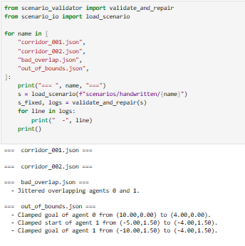
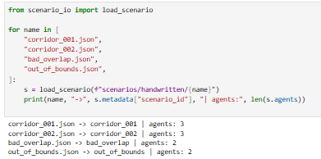
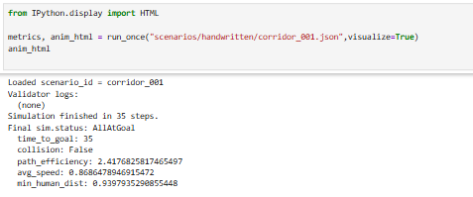
Notes:
Code for the full pipeline

Slide 7
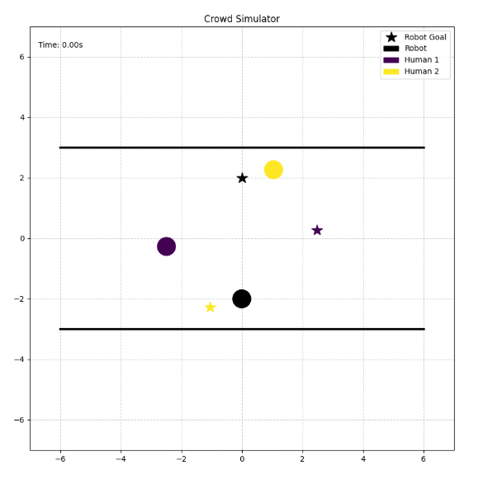
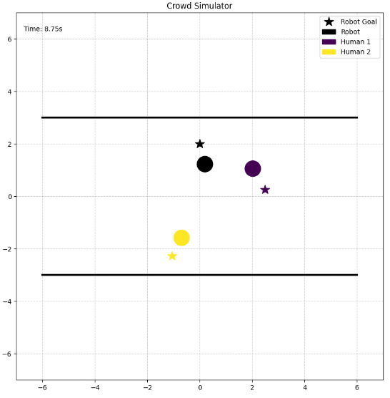
Notes:
Result of slide 5 last cell

Slide 8
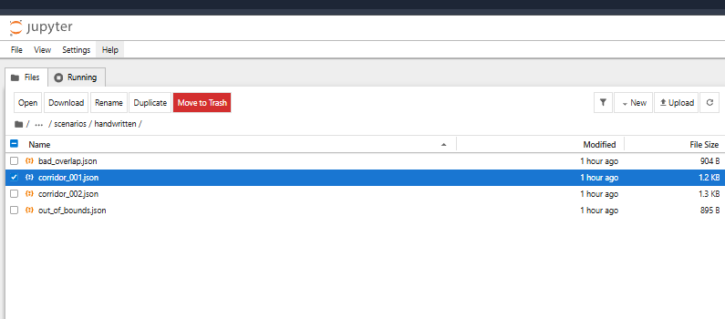
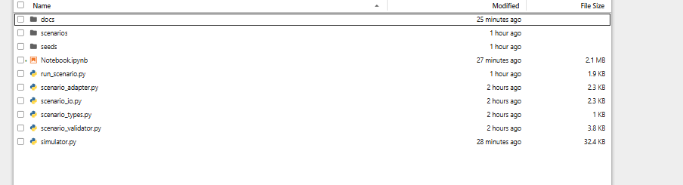
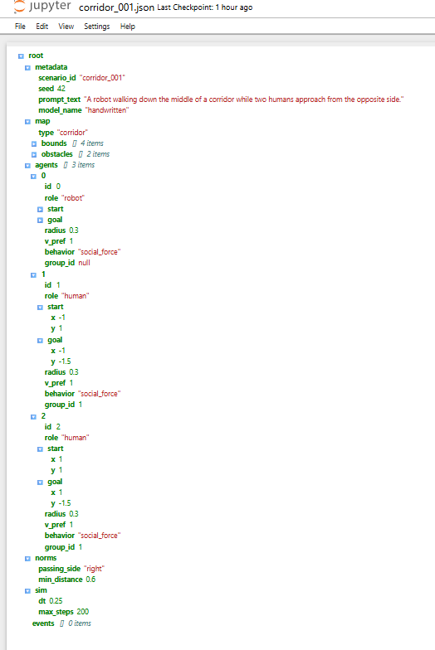
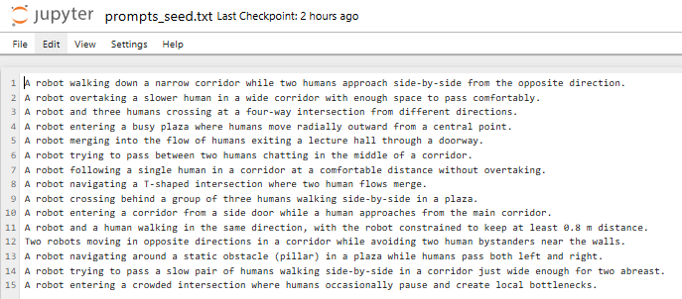
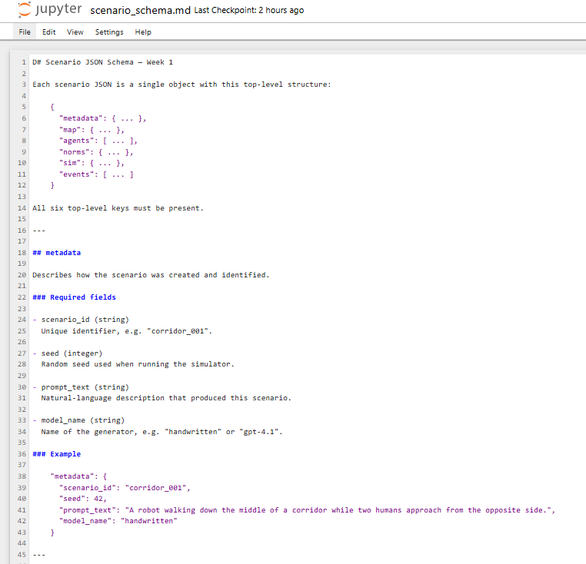
Notes:
Slide on structure of code

Slide 9
Timeline to Final Report
Week 1 – Design & plumbing (completed)
  JSON schema + examples
  Validator & auto-repair stubs
  Simulator adapter and smoke tests
  15 seed prompts
Week 2 – LLM integration + testing
  Structured prompts and JSON-only decoding; robustness to malformed output.
  Unit tests for validators; logging + manifest.
  Batch script: prompt → draft JSON → repair → save; generate ≈80 draft scenarios.

Slide 10
Timeline to Final Report
Week 3 – Scaling + policy baselines
  Expand to ≈200 repaired scenarios; coverage over corridor/intersection/plaza.
  Integrate ORCA; integrate one additional baseline (MPC/RL) with metrics logging.
Week 4 – Analysis + report
  Analyze feasibility / repair rates and diversity.
  Policy discrimination plots and ablations (e.g., validators on/off, temperature).
  Final write-up and presentation.

